Slide 1
Session 1
NAD1001: INTRODUCTION TO ARCHITECTURAL DESIGN

Slide 3
Welcome and Unit Overview
NAD1001 Introduction to Architectural Design
The purpose of this unit is to provide students with an overview of the built environment discipline, highlighting fundamental principles of design and digital proficiency. The unit provides students with an understanding of occupational health and safety (OHS) regulations, organisational policies and procedures, as well as the ability to master industry-standard computer-aided design software.
By incorporating culturally diverse knowledge systems, the unit broadens students' perspectives on spatial design and communication, fostering a more inclusive and socially aware approach to the field.
The unit also equips students with core architectural concepts and digital skills, laying a solid groundwork for their continued education and future professional practice in architecture.
Students will have an opportunity to apply their theoretical knowledge and skills in professional practice activities such as design projects.

Slide 4
Learning Outcomes
On successful completion of this unit, students will be able to:
Evaluate and integrate fundamental architectural design principles in the creation of spatial environments;
Comply with OHS regulations relevant to architectural practice and workplace environments;
Implement organisational policies and adhere to quality assurance standards in architectural projects, ensuring that designs are culturally informed and actively promote diverse cultures and traditions;
Employ suitable techniques for effectively documenting and communicating architectural designs; and
Produce two and three-dimensional drawings for architectural designs.

Slide 5
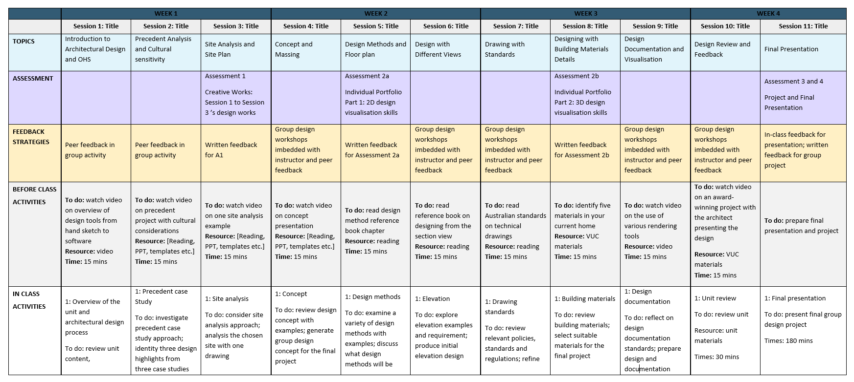
Unit Structure and Theme

Slide 6
Weekly Overview and Stages of Design
Week 1:
Pre-Design and Schematic Design
Introduction of Design, OHS, Precedent, Site
Main Design Tool: Hand Sketch and AutoCAD
Week 2:
Schematic Design and Design Development
Concept, Massing, Design Methods, Plan, Other Views
Main Design Tool: AutoCAD and REVIT
Week 3:
Design Development and Construction Documentations
Standards, Details, Building Materials, Documentation and Visualisation
Main Design Tool: REVIT
Week 4:
Final Project Review and Presentation

Slide 7
What to Expect? Typical Session Structure
For a typical session:
Part 1 material + activity (1 hour)
Part 2 material + activity (1 hour)
Part 3 software learning (1 hour)
* Some activities will be in studio mode, where students, peers and instructors will work together to discuss design progress and assessment feedback

Slide 8
Assessment Overview
Assessment No. | Name | Format | Percentage | Due Date
Assessment 1 | Creative Works | Individual | 20% | By Session 3
Assessment 2a | Individual Portfolio Part 1 (2D design visualisation) | Individual | 15% | By Session 5
Assessment 2b | Individual Portfolio Part 2 (3D design visualisation) | Individual | 15% | By Session 8
Assessment 3 | Final Design Project | Group | 40% | By Session 11
Assessment 4 | Final Presentation | Group | 10% | By Session 11

Slide 9
Activity 1: Key Design Stages and Core Services

Slide 10
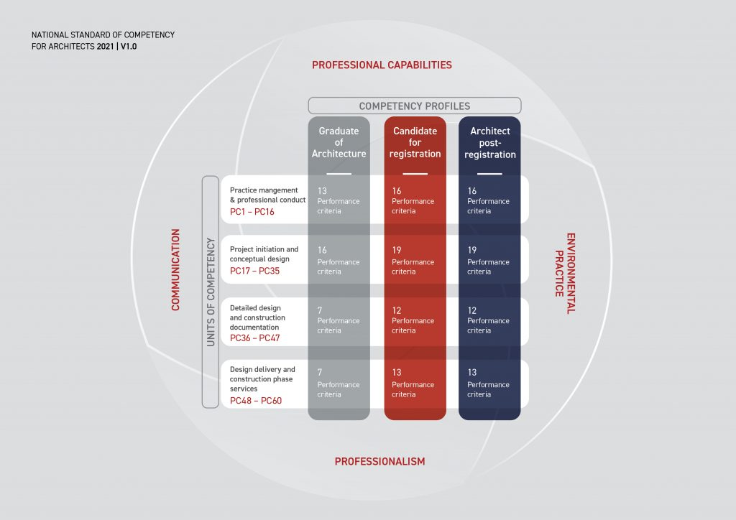

Slide 11
Activity 2: Showcase of Sample Final Outcomes

Slide 12
Activity 2: Showcase of Sample Final Outcomes

Slide 13
Session 1: OHS
NAD1001: INTRODUCTION TO ARCHITECTURAL DESIGN

Slide 14
OHS in Architectural Design
What is OHS in architectural design?
Occupational Health and Safety (OHS) in architectural design refers to the consideration of health and safety measures during the planning, design, and execution phases of building projects. OHS aims to protect not only those involved in the construction process but also those who will use or inhabit the buildings once they are completed.

Slide 15
Key Aspects of OHS in Architectural Design
1. Design for Safety:
Risk Mitigation: Architects integrate safety measures into their designs to mitigate risks associated with construction and usage. This includes considering the safety of construction workers during the building phase and the occupants during the building's operational phase.
Ergonomics: Designing spaces that contribute to the comfort, efficiency, and safety of people who use them. This involves thoughtful placement of structures and elements to reduce strain and injury.
2. Compliance with Regulations:
Building Codes: Architects must adhere to local and international building codes that include safety standards and requirements. These codes ensure that the buildings are safe for occupancy and use.
Accessibility Standards: Ensuring that buildings are accessible to people with disabilities is a critical component of architectural design, which involves following standards like the ADA (Americans with Disabilities Act) in the U.S. or similar regulations in other countries.
3. Material and Structural Safety:
Material Selection: Choosing appropriate materials that are durable and safe for both the construction process and the building's functionality.
Structural Integrity: Designing structures that will withstand local environmental conditions and potential disasters like earthquakes, floods, and fires.
4. Sustainability and Health:
Environmental Health: Incorporating designs that minimize negative impacts on the environment and promote environmental health, such as using non-toxic materials and ensuring proper ventilation.
Sustainable Design: Employing methods that not only enhance efficiency and usability but also promote sustainability, reducing the building's carbon footprint.
5. Emergency Preparedness:
Evacuation Routes: Planning clear and accessible evacuation routes for emergencies.
Fire Safety: Integrating fire exits, fire-resistant materials, and fire alarm systems as integral parts of the design.

Slide 16
Key OHS Regulations and Standards
Building Act – Most Powerful
Building Regulations
NCC Building Code of Australia
Australian Standards
Other Publications and Documents

Slide 17
Role of Designers in OHS
Read Designing Safter Buildings and Structures- A Guide to Section 28 of Occupational Health and Safety Act 2004
Discuss: What is applicable scope? Who is a designer?

Slide 18
Applicable Scope
The duty applies to persons who design any of the following:
(a) buildings or structures to be used as workplaces
(b) buildings or structures that are occasional workplaces, such as sports stadiums or bridges under repair or maintenance;
(c) parts of the building or structure, including fixtures integral to the use of the building or structure as a workplace;
(d) temporary structures to be used as workplaces other than plant.

Slide 19
Who is a designer?
WorkSafe considers that designing includes:
Making preliminary sketches, plans or drawings for a building or a structure before it is constructed, commissioned and used as a workplace; and
Making specialist, expert or technical decisions for incorporation into the design that may affect the risk to health or safety of people using the building or structure as a workplace.
Designers may include: architects or building designers or draftspersons who undertake the design.
on behalf of the clients, including conducting a feasibility study, producing a schematic design or preparing construction documentation or tendering, depending on the contractual arrangement;
other designers who participate in the design or make decisions during any. of the project phases. These may include: engineers; interior designers; industrial designers, and contractors

Slide 20
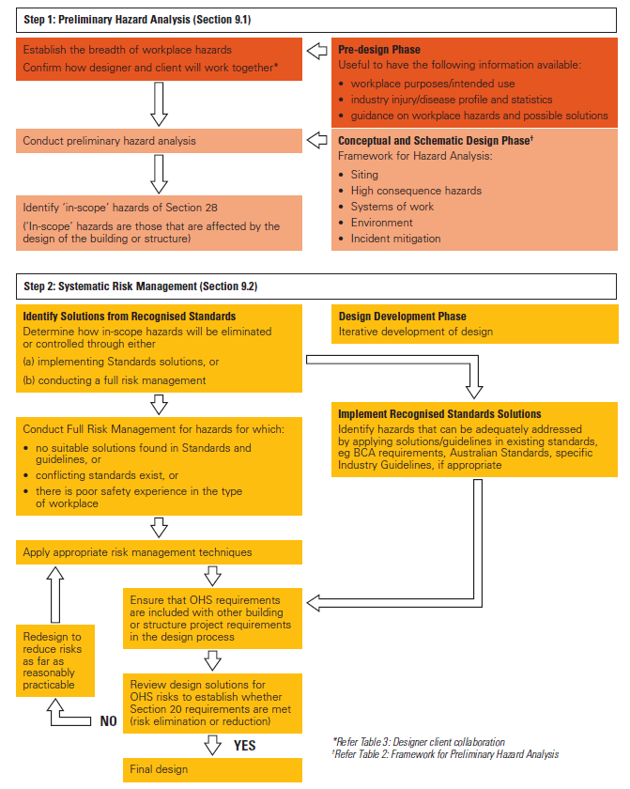
Integrating OHS in Design Processes
Recommended steps in the systematic approach to health and safety in design

Slide 21
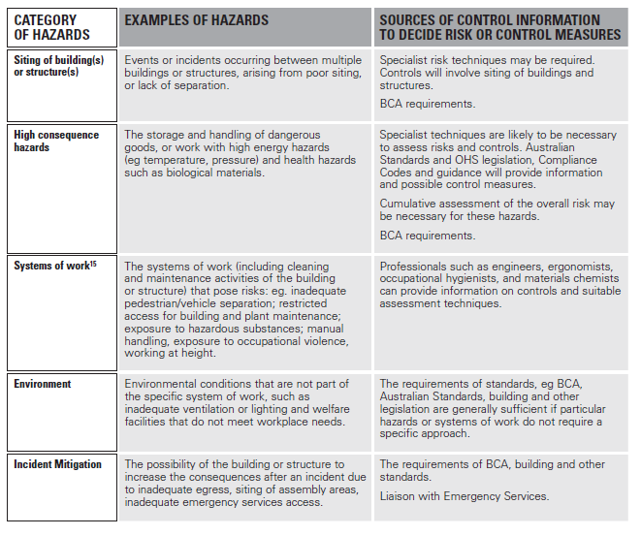
Integrating OHS in Design Processes
Framework for Preliminary Hazard Analysis
Source: Designing Safer Buildings and Structures 2005

Slide 22
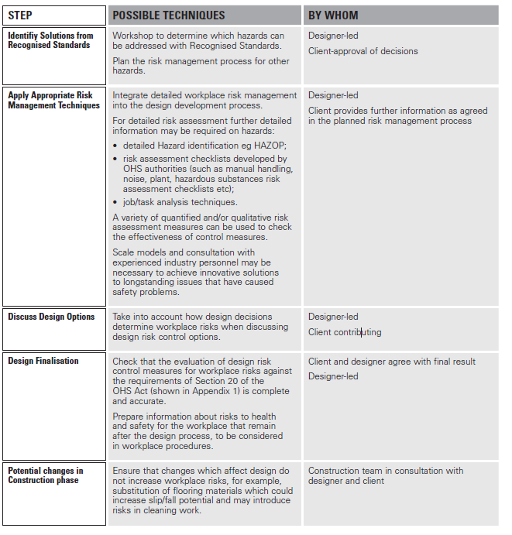
Integrating OHS in Design Processes
Systematic Risk Management
Source: Designing Safer Buildings and Structures 2005

Slide 23
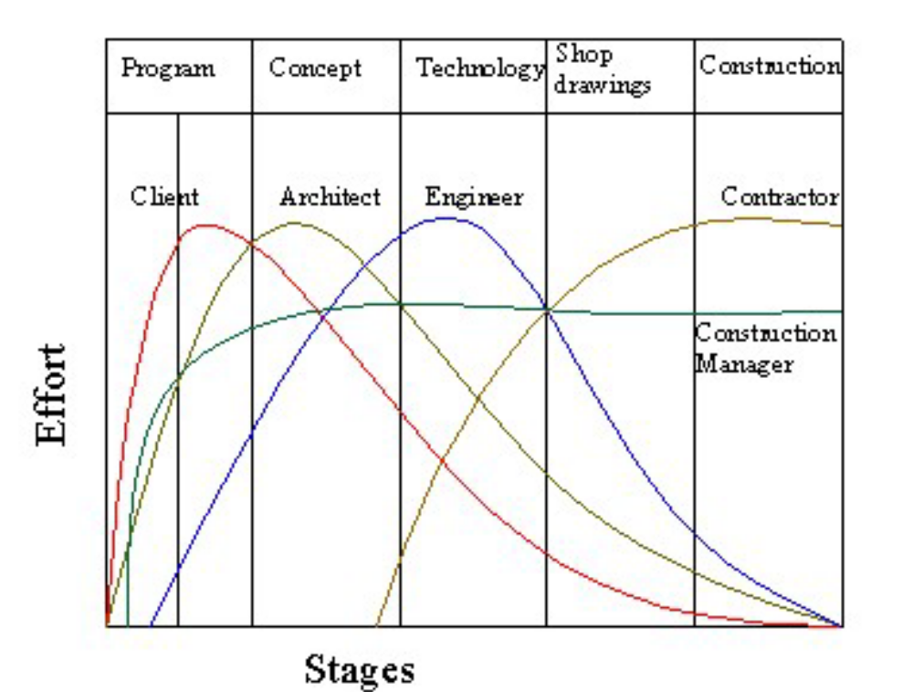
Integrating OHS in Projects – Project Involvement
Designer is not the only one involved in ensuring OHS

Slide 24
Overview of Roles Involved in an Architectural Project
Design Phase: Architects. Civil Engineers, Mechanical Engineers, Electrical Engineers, Plumbing Engineers, Landscape Architects, Interior Designers, Environmental Consultants, Surveyors, Urban Planners
Pre-Construction Phase: Project Managers, Cost Estimators, Legal Advisors, Safety Officers
Construction Phase: General Contractor, Laborers, Site Managers, Quality Control Specialists
Subcontractors:
Post-Construction Phase: Commissioning Agents, Building Inspectors, Maintenance Engineers/Managers
  Flooring Contractors
  Carpenters
  HVAC Technicians
  Electricians
  Plumbers
  Concrete Contractors
  Masonry Contractors
  Roofing Contractors
  Drywall Contractors
  Painting Contractors

Slide 25
Practical OHS Considerations in Design
Fire Safety
Fire-Resistance Ratings
Fire-resistance ratings are measured in hours or fractions of an hour and reflect the amount of time that a material or assembly of materials will resist fire exposure. When beginning design of a building, the initial code analysis must consider the desired occupancy and the desired height and area to determine the minimum allowable construction type for fire ratings.
Egress:
Continuous and unobstructed way of exit travel from any point in a building or facility to an area of refuge, a horizontal exit, or a public way.
A means of egress comprises vertical and horizontal travel and may include intervening room spaces, doorways, hallways, corridors, passageways, balconies, ramps, stairs, enclosures, lobbies, horizontal exits, courts, and yards.

Slide 26
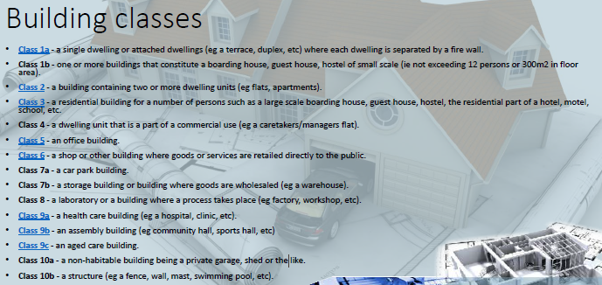
Practical OHS Considerations in Design
Fire Safety

Slide 27
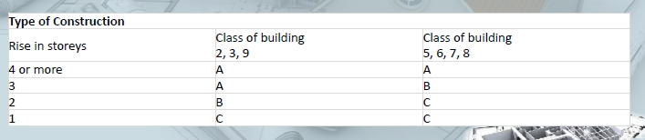
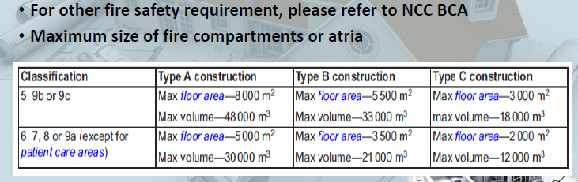
Practical OHS Considerations in Design
Fire Safety

Slide 28
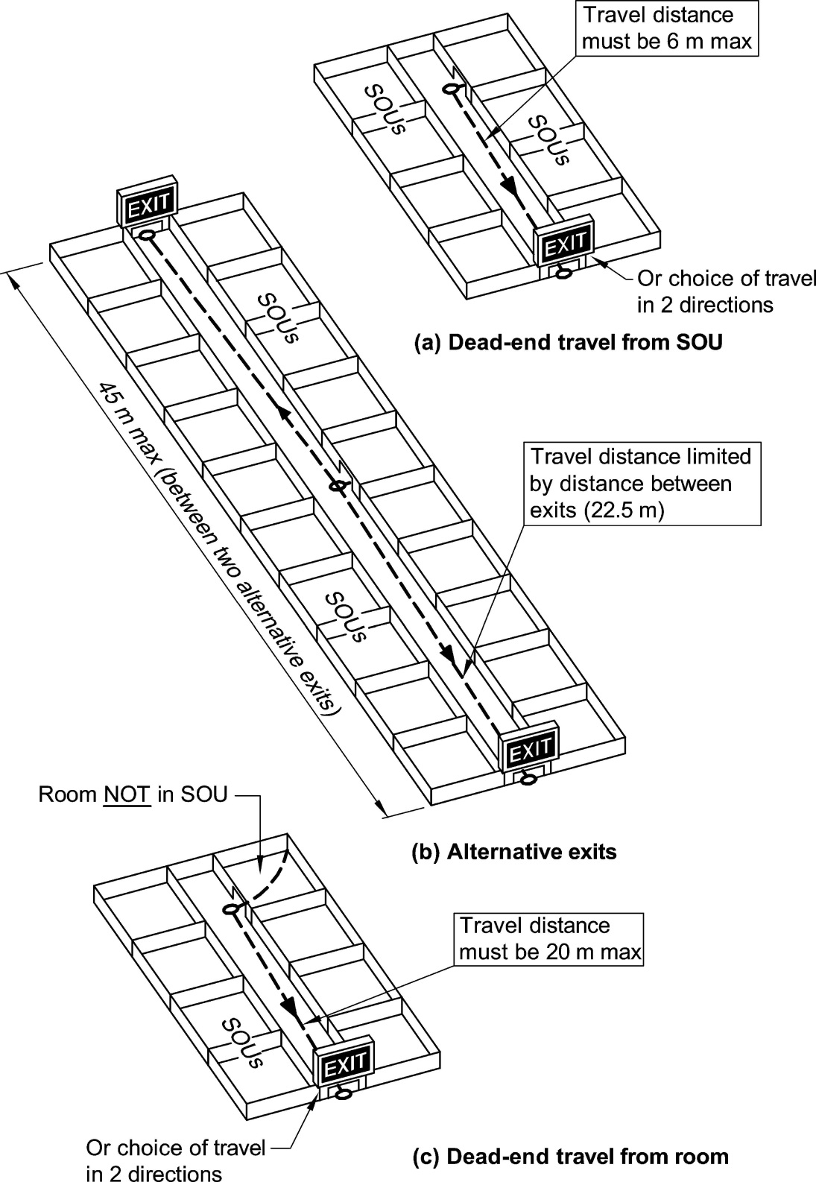
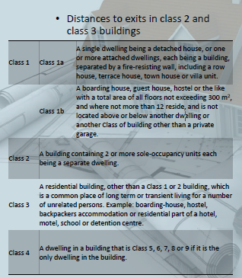
Practical OHS Considerations in Design Fire Safety
Source: NCC 2022 Volume One - National Construction Code

Slide 29
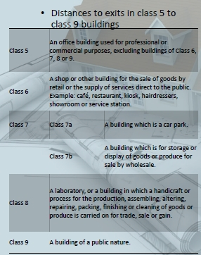
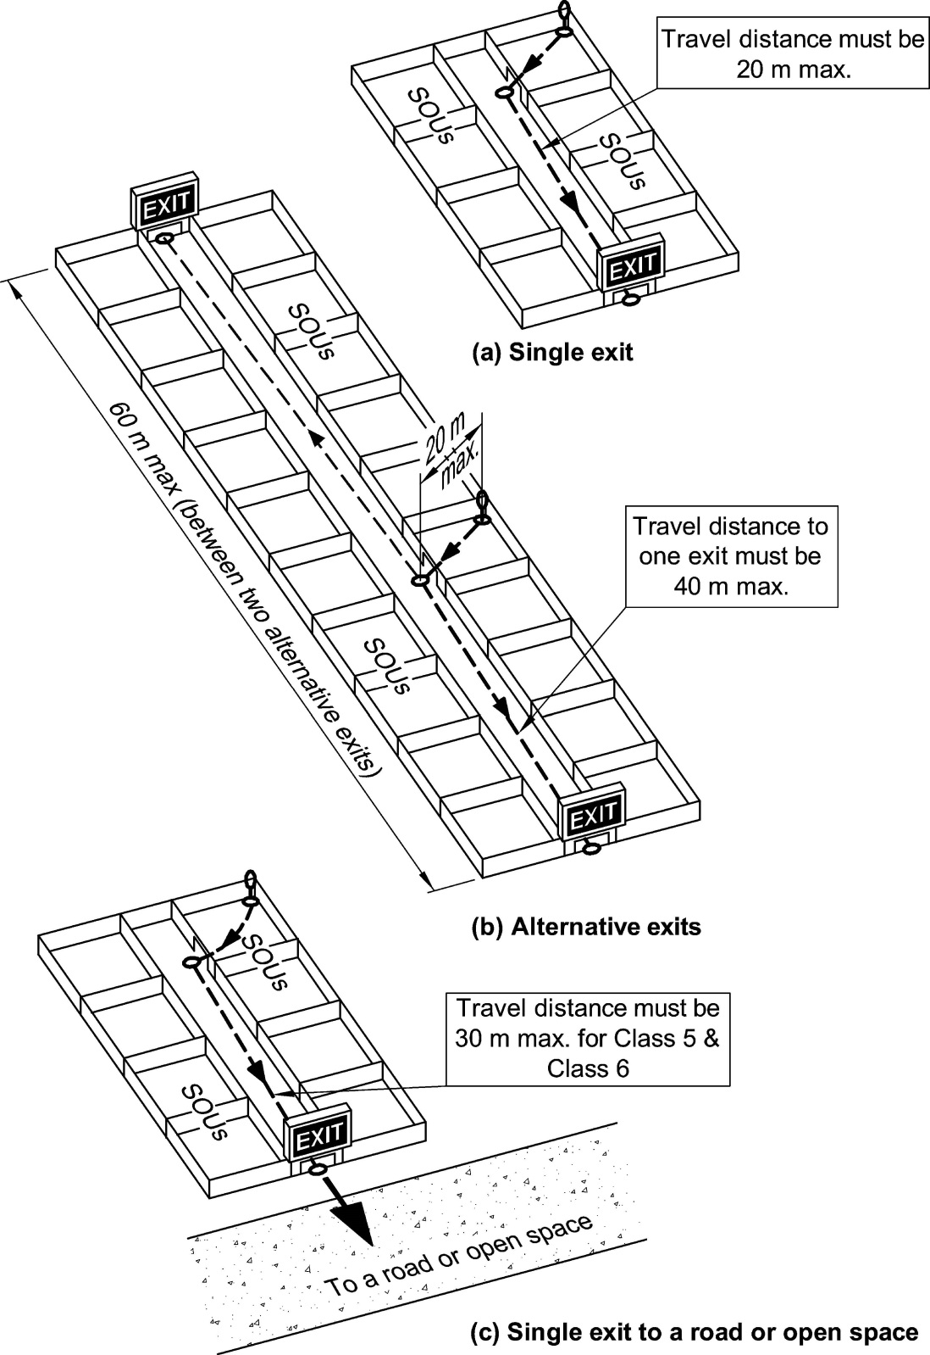
Practical OHS Considerations in Design Fire Safety

Slide 30
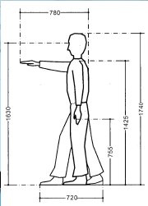
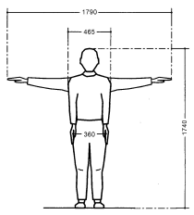
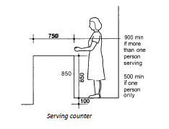
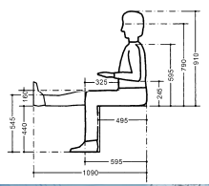
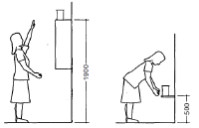
Practical OHS Considerations in Design - Ergonomics
Dimensions of adult males
Dimensions of adult females
• Anthropometrics is the science concerned with the measurement of humankind.
• Ergonomics is the process of designing or arranging workplaces, products and systems so that they fit the people who use them.
Source: AS 1428.1—2009 Design for access and mobility

Slide 31
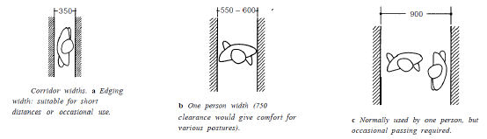
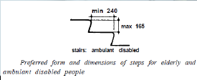
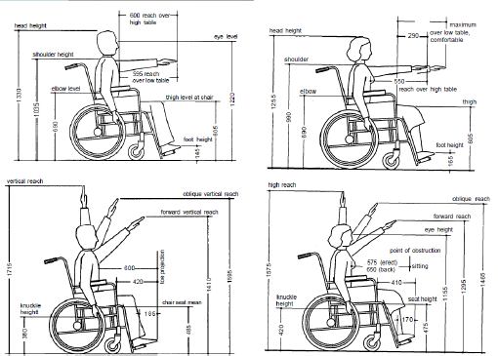
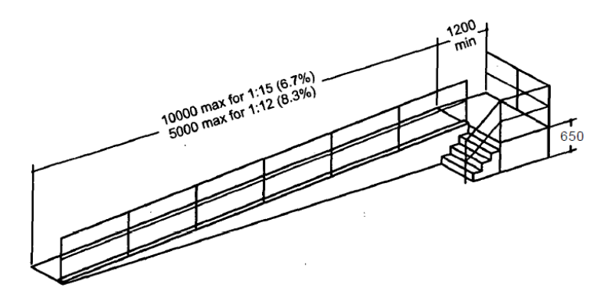
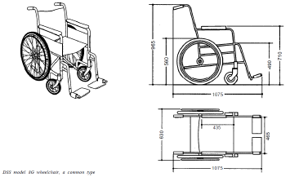
Practical OHS Considerations in Design - Ergonomics
Source: AS 1428.1—2009 Design for access and mobility

Slide 32
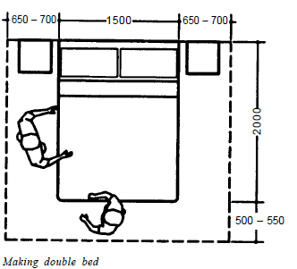
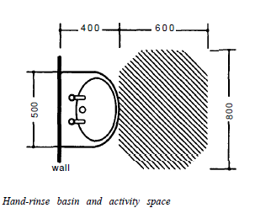
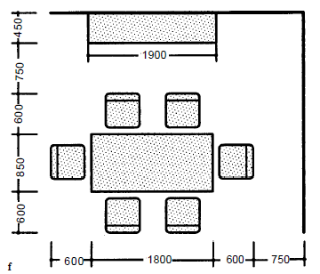
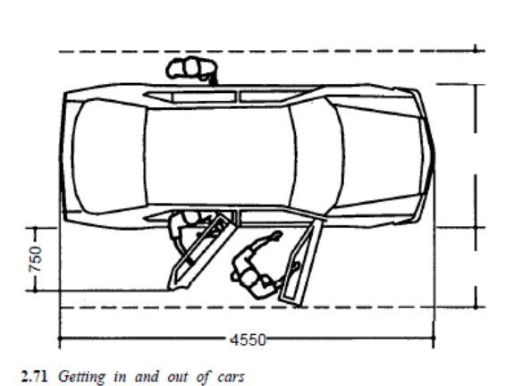
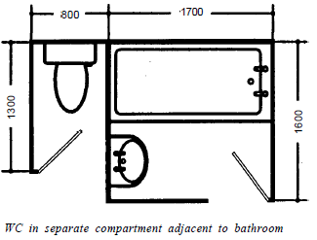
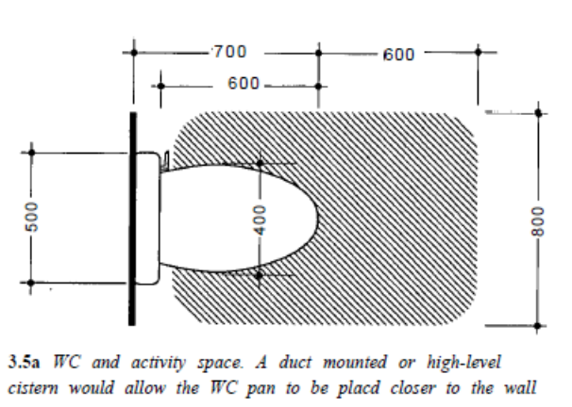
Practical OHS Considerations in Design - Ergonomics
Source: AS 1428.1—2009 Design for access and mobility

Slide 33
Practical OHS Considerations in Design - Ergonomics Room Height
Room heights in NCC
The height of rooms and other spaces must be not less than—
(a)in a Class 2 or 3 building or Class 4 part of a building—
(i)a kitchen, laundry, or the like —2.1 m; and
(ii)a corridor, passageway or the like —2.1 m; and
(iii)a habitable room excluding a kitchen —2.4 m; and
(iv)in a room or space with a sloping ceiling or projections below the ceiling line within—
(A)a habitable room—
(aa)in an attic —a height of not less than 2.2 m for not less than two‐thirds of the floor area of the room or space; and
(bb)in other rooms —a height of not less than 2.4 m for not less than two‐thirds of the floor area of the room or space; and
(B)a non‐habitable room —a height of not less than 2.1 m for not less than two‐thirds of the floor area of the room or space; and when calculating the floor area of a room or space, any part that has a ceiling height of less than 1.5 m is not included

Slide 34
Practical OHS Considerations in Design
Workplace Injury
• The Workplace Injury Rehabilitation and Compensation Act 2013(WIRC Act) addresses what happens when a Victorian worker is injured or killed
What does it cover?
Insurance
workers compensation
Claims
Rehabilitation
return to work
dispute resolution

Slide 35
Practical OHS Considerations in Design - Hazardous Building Materials
The Workplace Manager and/or Management OHS Nominees are to contact the Department’s Asbestos Customer Call Centre to identify the presence of hazardous building materials within the workplace. The results of this assessment should be recorded in a hazardous building material report provided by Cushman and Wakefield.

Slide 36
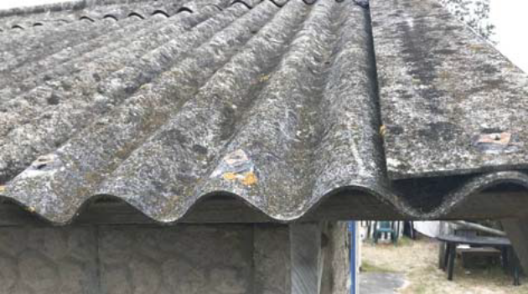





Practical OHS Considerations in Design - Hazardous Building Materials
Source: Newcastle Herald 2018
Asbestos
Polychlorinated Biphenyls (PCB)
Lead-Based Paint
Synthetic Mineral Fibres (SMFs)
CCA-treated timber

Slide 37
Key OHS Regulations and Standards
Section 28 & Building Code of Australia
The focus of Section 28 is design of a building or structure which is intended to be used as a workplace. It requires consideration of a broad range of occupational health and safety matters which may impact on the people who use it as a workplace. This may include consideration of work tasks likely to be carried out at the workplace because of the intended use of the building.

Slide 38
Activity 3: Identify a building in Australia that unsuccessfully integrated OHS

Slide 39
Session 1: Design Principles

Slide 40
Activity 4: What is architecture?

Slide 41
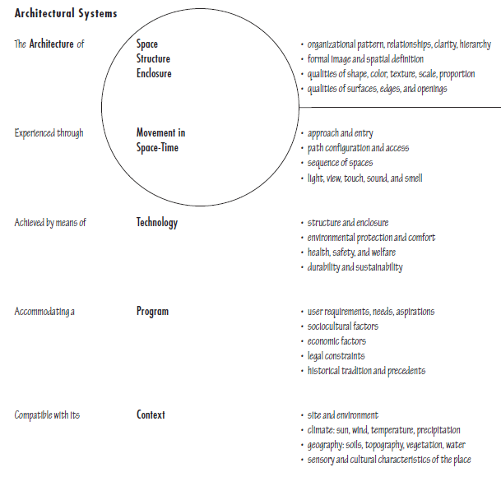
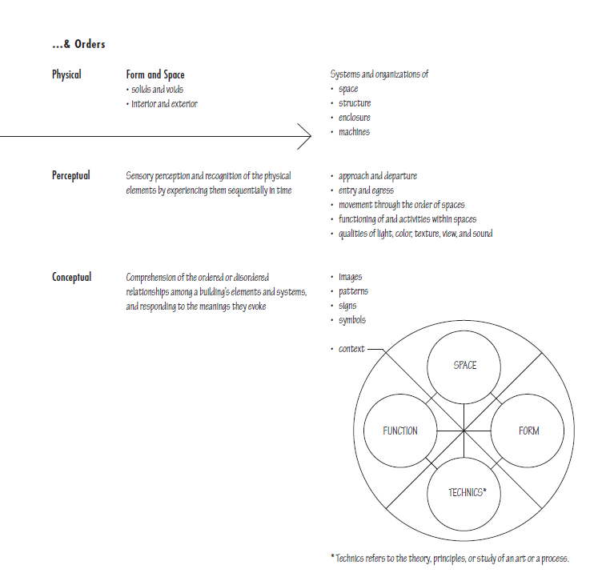
Architectural Systems
Source: Architecture Form, Space and Order by Francis D.K. Ching

Slide 42
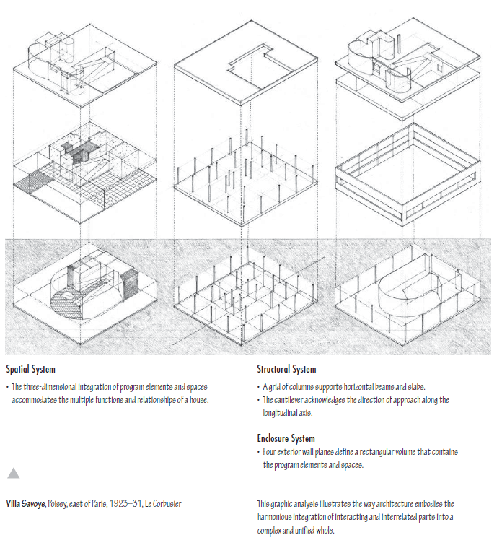
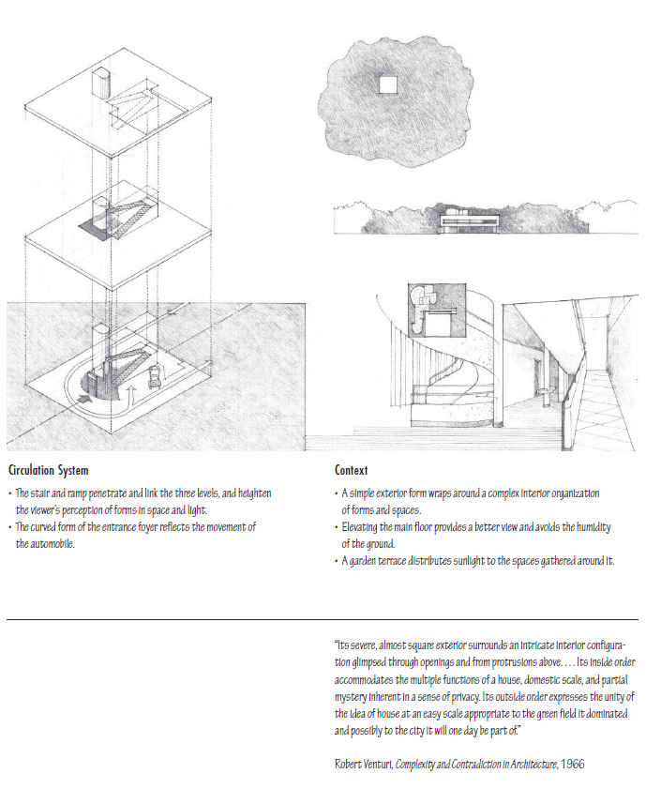
Architectural Systems
Source: Architecture Form, Space and Order by Francis D.K. Ching

Slide 43
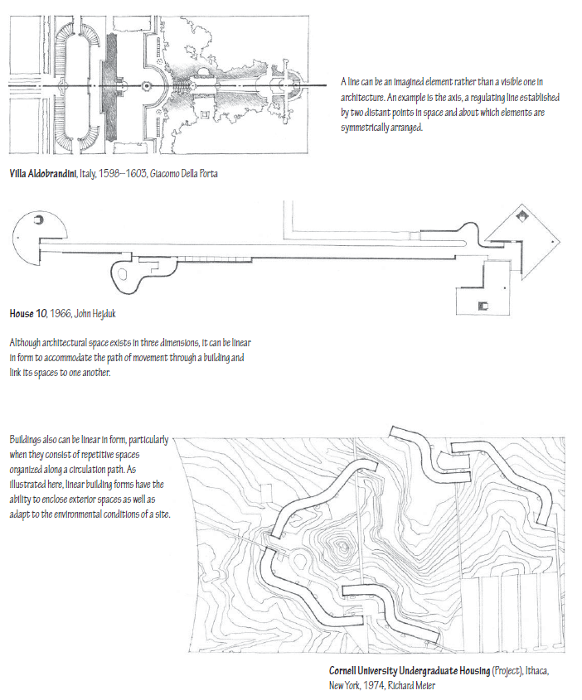
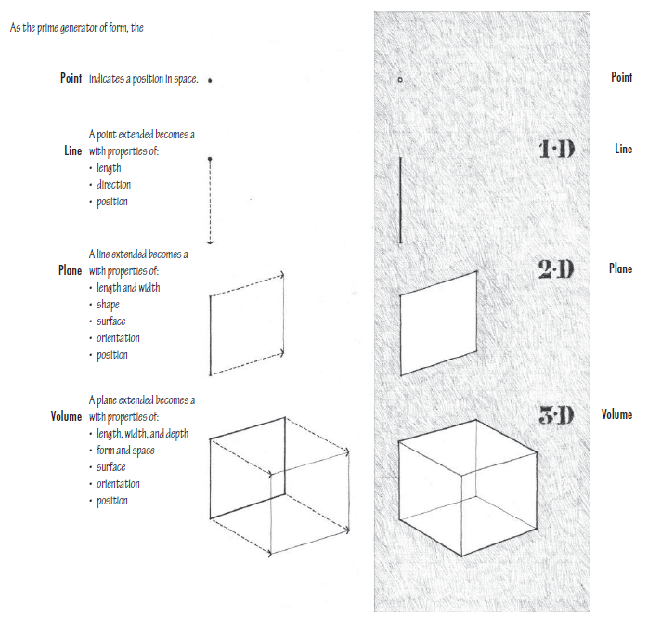
Primary Elements - Line
Source: Architecture Form, Space and Order by Francis D.K. Ching

Slide 44
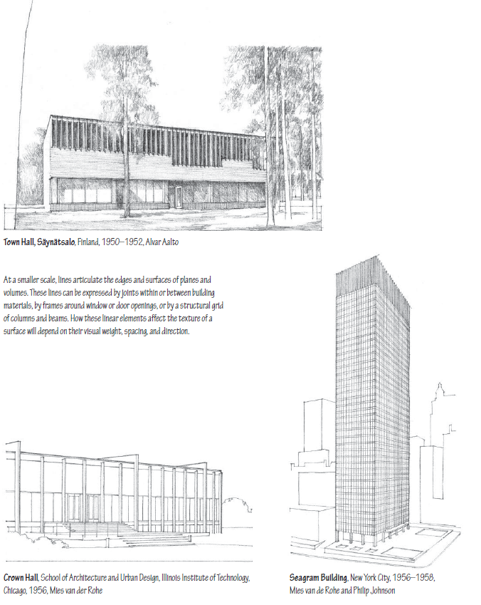
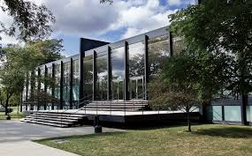
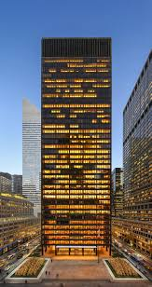
Primary Elements - Line
Source: Architecture Form, Space and Order by Francis D.K. Ching

Slide 45
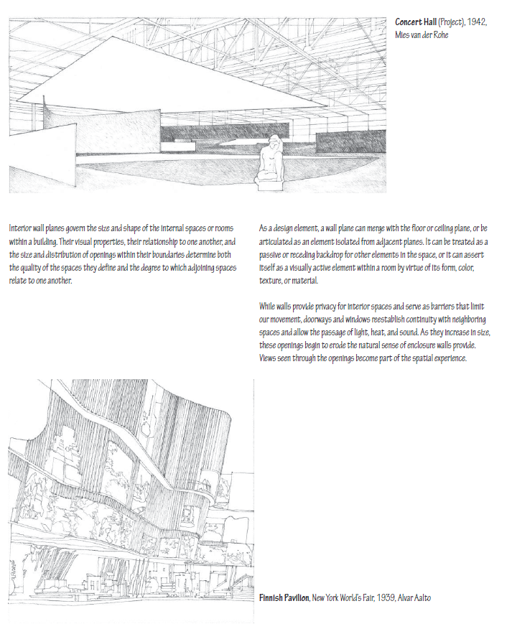
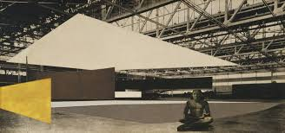

Primary Elements - Plane
Source: Architecture Form, Space and Order by Francis D.K. Ching

Slide 46
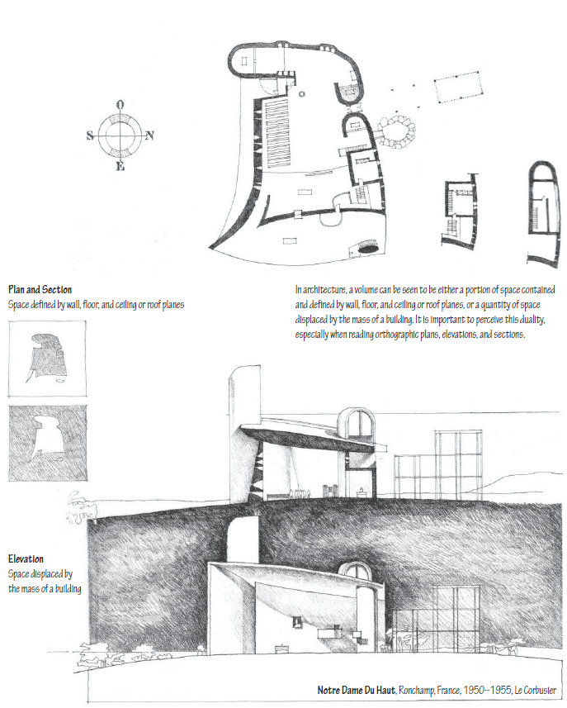
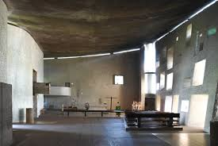

Primary Elements -Volume
Source: Architecture Form, Space and Order by Francis D.K. Ching

Slide 47
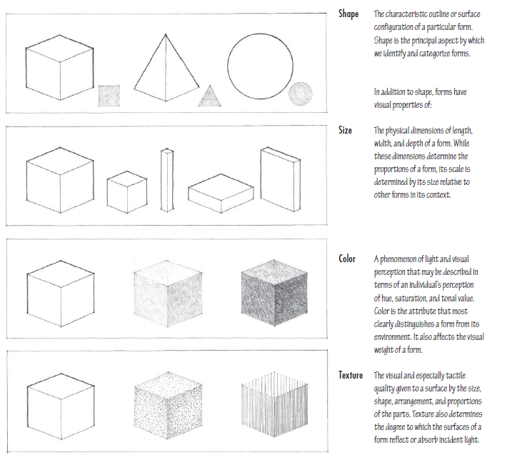

Form
Source: Architecture Form, Space and Order by Francis D.K. Ching

Slide 48
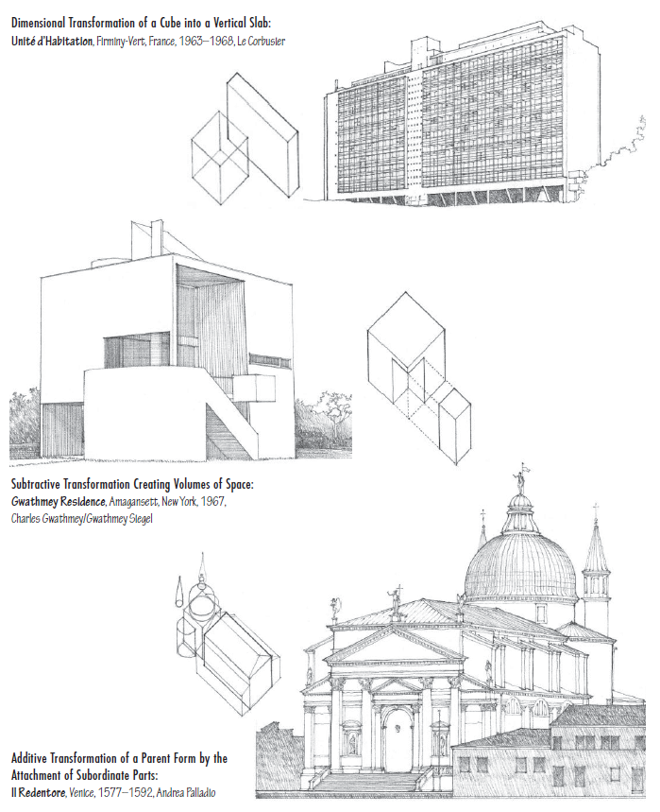
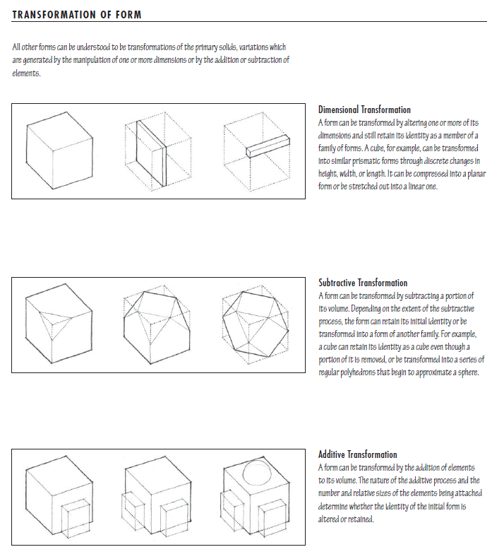
Form
Source: Architecture Form, Space and Order by Francis D.K. Ching

Slide 49
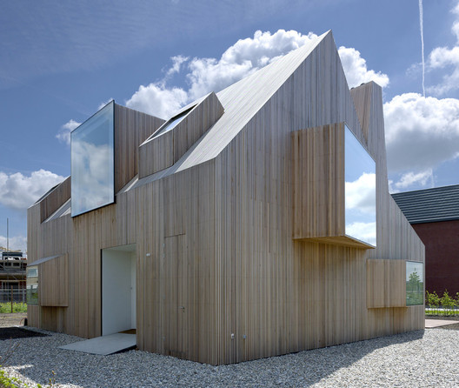


Form – what principle was applied?
Dimensional/substrative/additive

Slide 50
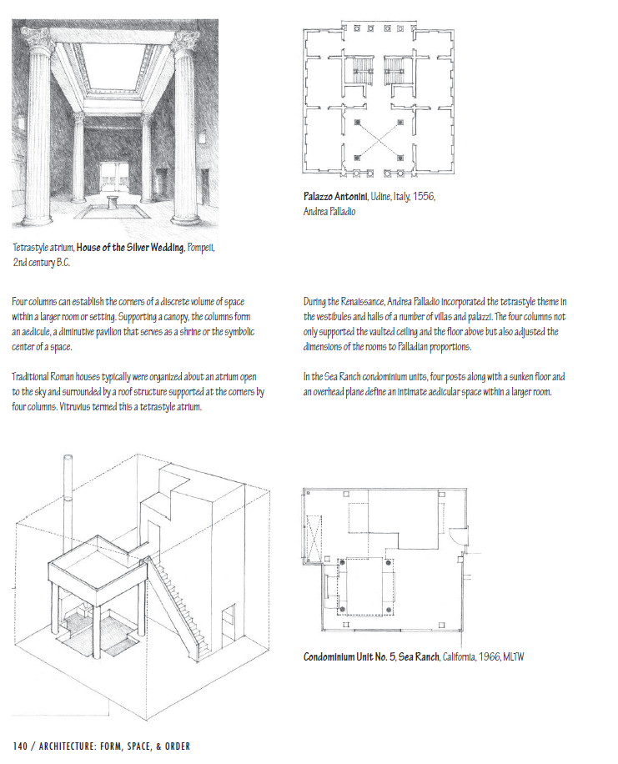
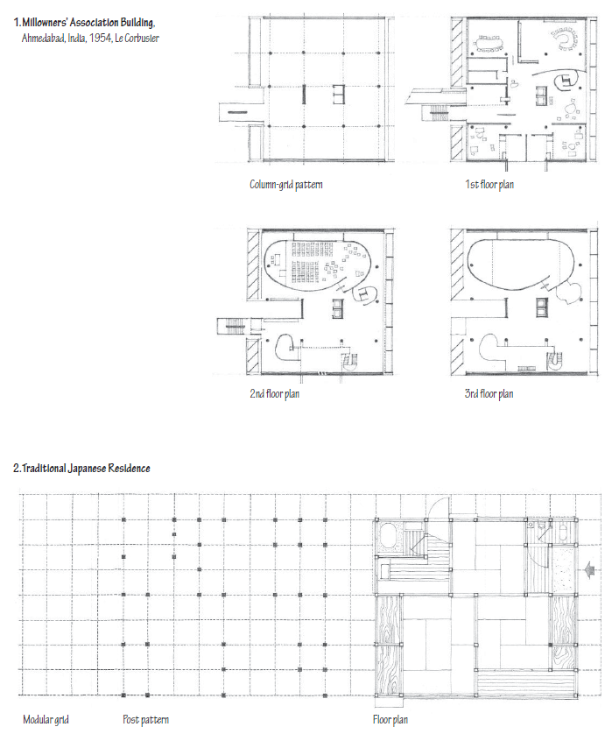
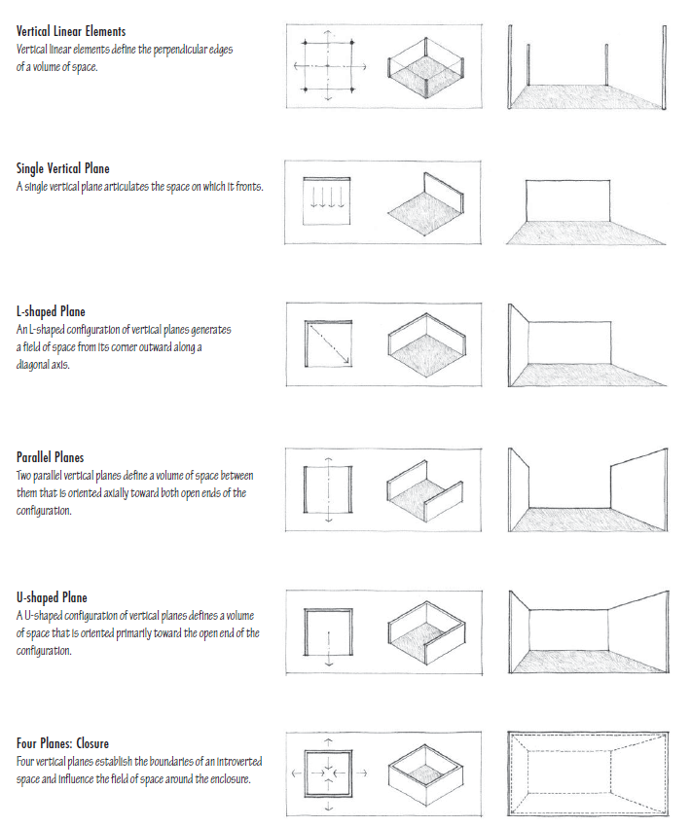
Form and Space
Source: Architecture Form, Space and Order by Francis D.K. Ching

Slide 51


Form and Space – what principle was applied ?

Slide 52


Form and Space
Source: Architecture Form, Space and Order by Francis D.K. Ching

Slide 53


Organisation
Source: Architecture Form, Space and Order by Francis D.K. Ching

Slide 54



Circulation
Source: Architecture Form, Space and Order by Francis D.K. Ching

Slide 55



Proportion and Scale
Source: Architecture Form, Space and Order by Francis D.K. Ching

Slide 56

Other Ordering Principles
Source: Architecture Form, Space and Order by Francis D.K. Ching

Slide 57
Activity 5: Initial Design Brainstorm

Slide 58
References
Architects Accreditation Council of Australia. (2021). 2021 National Standard of Competency for Architects. https://aaca.org.au/wp-content/uploads/2021-NSCA.pdf
Worksafe. (2005). Designing Safer Buildings and Structures. https://www.worksafe.vic.gov.au/resources/designing-safer-buildings-and-structures
Australian Building Codes Board. (2022). National Construction Code Volume One. https://ncc.abcb.gov.au/editions/ncc-2022/adopted/volume-one
Australian Standards. (2021). AS 1428.1 Design for Access and Mobility. https://store.standards.org.au/product/as-1428-1-2021
Newcastle Herald. (2018). Hunter Asbestos Deaths are Increasing. https://www.newcastleherald.com.au/story/5503988/hunter-asbestos-deaths-are-increasing/
Ching, F. (2023). Architecture Form, Space and Order. Wiley

Slide 59
Thank you
Questions?

